Slide 1
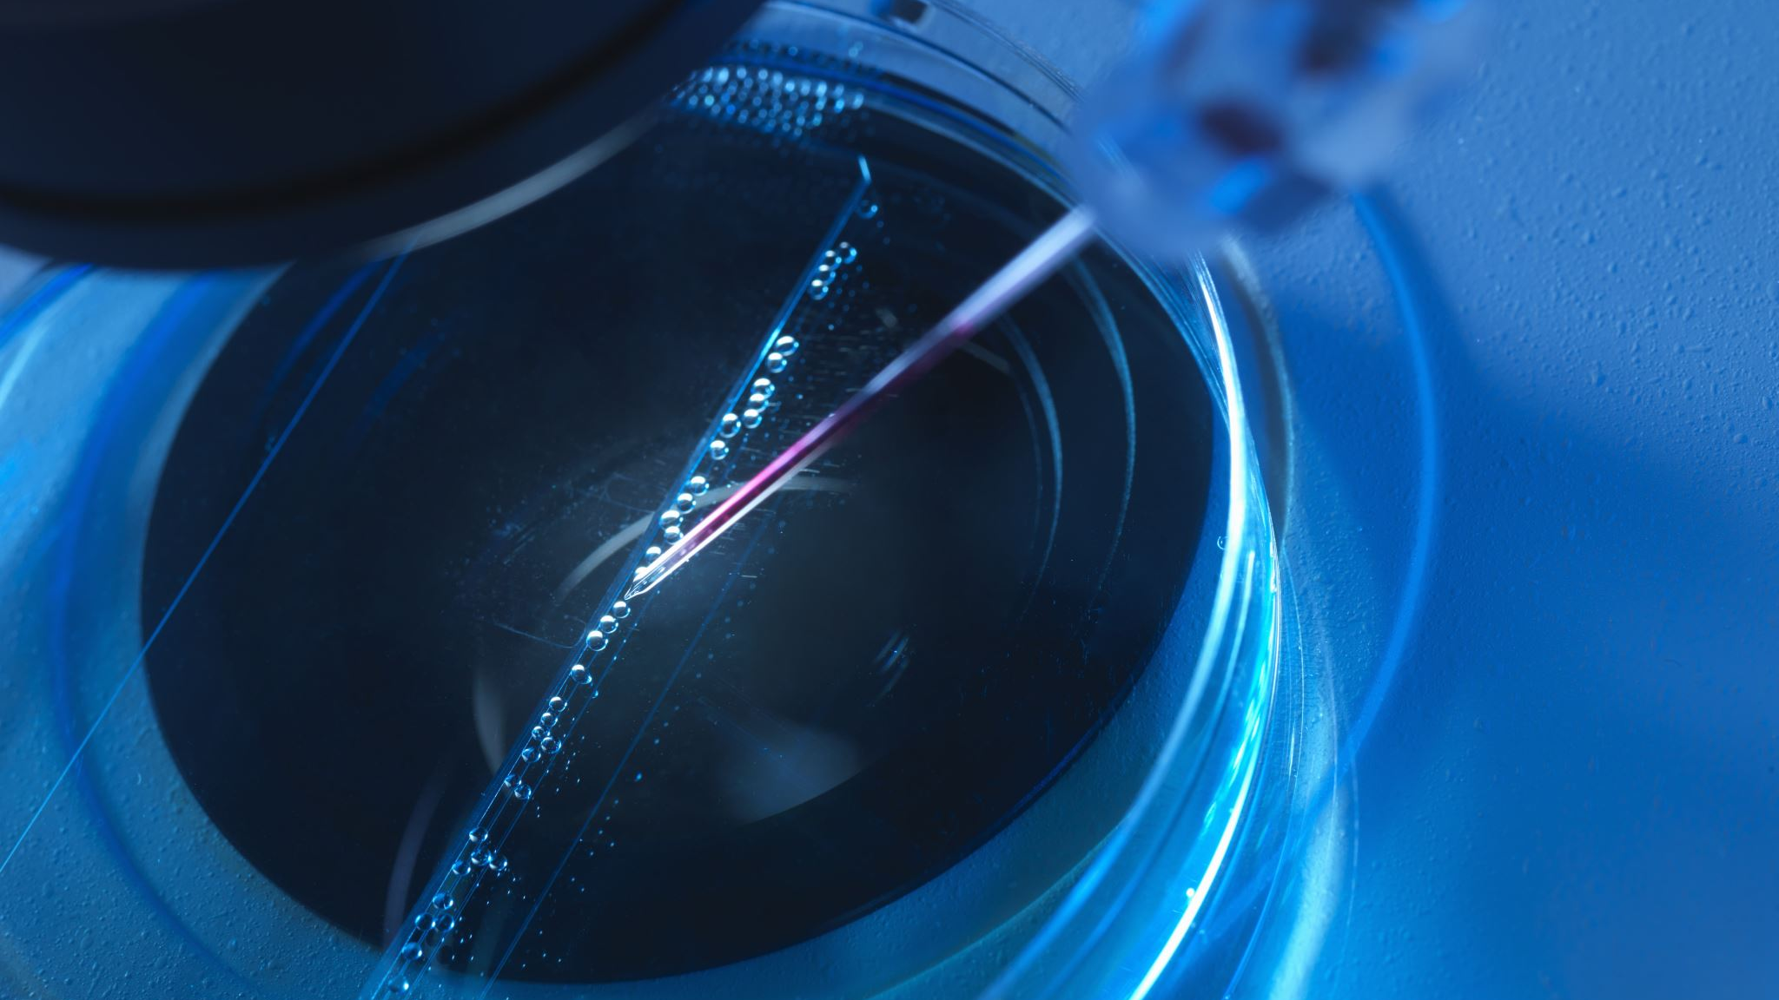
Detection of Radiation II
RT4220 – Lecture #11
Kedree Proffitt
WSU
10/23/2025

Slide 2
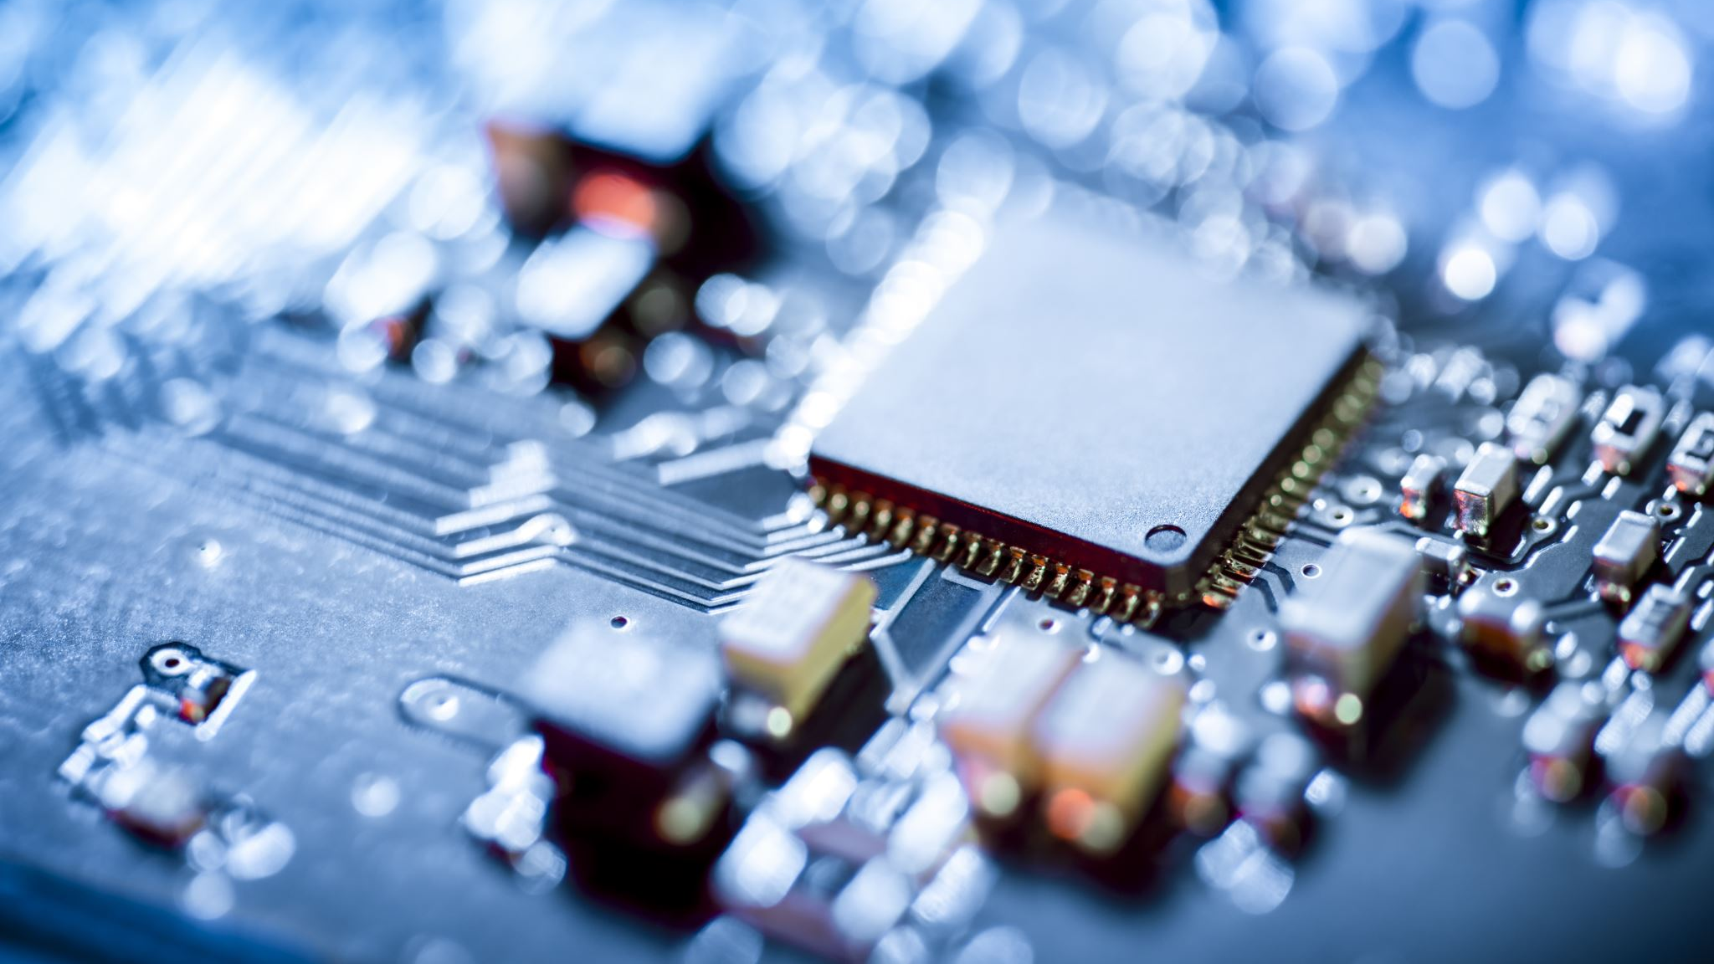
Semiconductors
Why would trucks need musical direction?

Slide 3
Bushberg Summary: Types of Detectors
Detection Method:
Ionization of material between electrodes (gaseous)
Production of light via UV excitation or visible light (scintillators)
Film Exposure (film)
Diode Activation (semiconductor)
Information Produced:
Counters
GM
Spectrometers
Scintillators
Dosimeters
Ionization Chambers

Slide 4
Operating Modes
Pulse Mode:
Each event is processed individually
Charge Mode:
Individual interactions are averaged together to form a net signal

Slide 5
Semiconductor Detector Motivation
Semiconductor detectors are a form of solid-state detector
Analogous to ionization chambers or proportional counters in purpose
  The size of the signal is proportional to energy deposited
Commonly use amorphous silicon, sometimes germanium or CZT
Ion production is MUCH more efficient in solid-state:
  Air: 34 eV/i.p.
  Si: 3.6 eV/i.p.
  Ge: 2.8 eV/i.p.
Because of the increased sensitivity and energy dependence → can count individual events and differentiate energies

Slide 6
How Semiconductors Work
Electrons exist in energy bands (valence, conduction)
In semiconductors, the forbidden zone between the bands is very small (1 ev or less)
Sources of energy (such as ionization, UV, or heat) can move electrons in valence band to conduction band
This creates current, if a voltage is applied
The current created is tiny, we use doping to turn the material into a diode so that we can see the tiny current

Slide 7
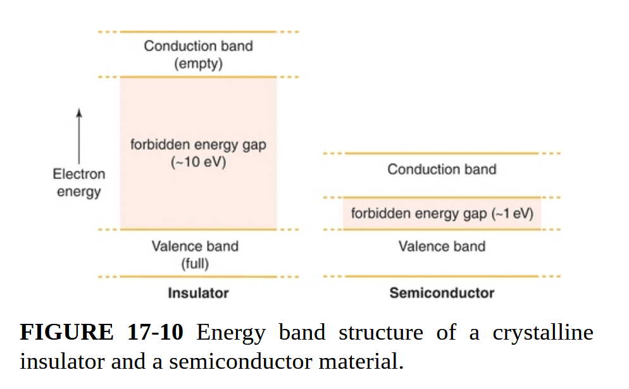

Slide 8
How Diodes Work
Doping the silicon with impurities (boron, phosphorus) creates charge carriers
One side of the diode is doped with boron which has more valence electrons than the silicon (n-type); the other side is doped with phosphorus which act like electron sinkholes (p-type)
If we apply a voltage, fun things happen:
  Forward Bias: we see constant current flow
  Reverse Bias: we see next to zero current flow (DESIREABLE)
The reverse bias allows us to see energy deposition from ionizing radiation as the signal is no longer drowned out by the noise caused by forward bias or no bias

Slide 9
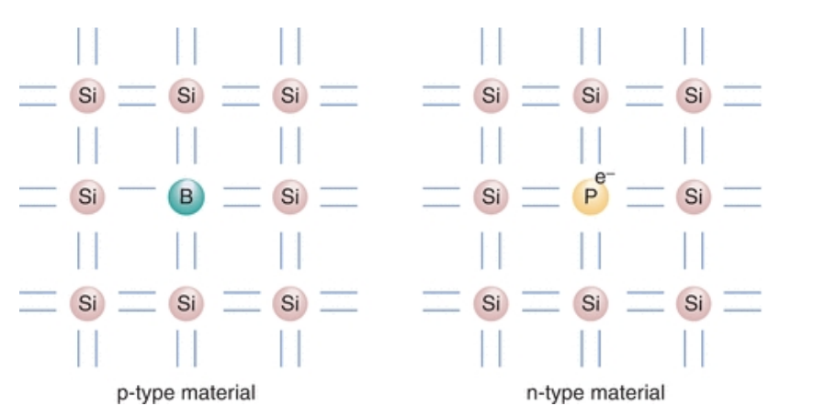

Slide 10
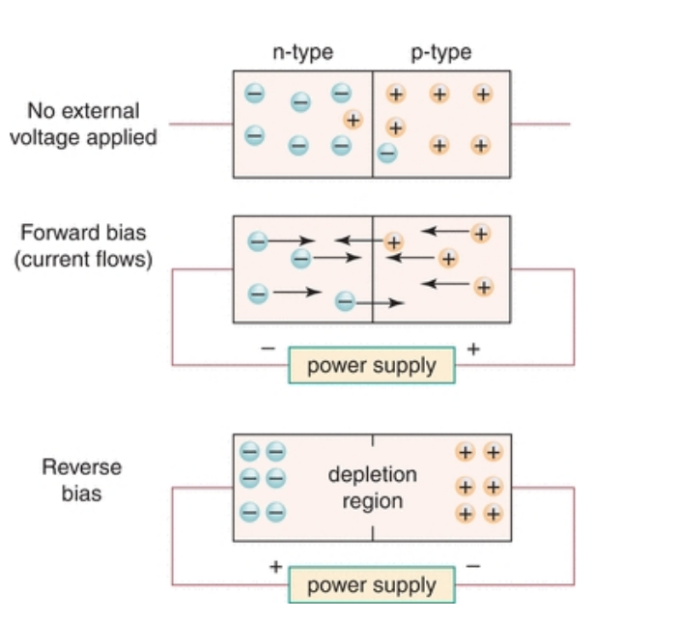

Slide 11
Types of Semiconductor Detectors
Photodiodes
(Fluoroscopy)
Liquid Nitrogen-Cooled Germanium
(Nuclear Medicine)
Cadmium Zinc Telluride [CZT]
(Nuclear Medicine)
Flat Panel Displays
(Mammography, some Radiology?)
Diodes and MOSFETs
(Therapy)

Slide 12
Photodiodes
Ubiquitous and cheap
Converts visible light into electrical signals
DOES NOT DETECT RADIATION
Used in scintillators to convert scintillated light into a digital signal

Slide 13
Liquid Nitrogen-Cooled Germanium
Very expensive and limited scope of use
Great energy resolution
Used for identifying individual gamma emitters in mixed radionuclide samples

Slide 14
CZT
We have one now!
Used in nuclear medicine imaging as an alternative to scintillators and germanium
Operated at room temperature

Slide 15
Flat Panel Displays
Amorphous selenium is often used in radiology and mammography
Provides a higher spatial resolution than scintillators
Everything is digital signal natively

Slide 16
Therapy Diodes and MOSFETS
Very small detectors, great for measuring scatter dose just outside of a beam
Also used for small-field dosimetry and beam characterization
Supplements ionization chambers, does not replace them
MOSFETs are very similar to diodes, the added complexity is not useful here

Slide 17
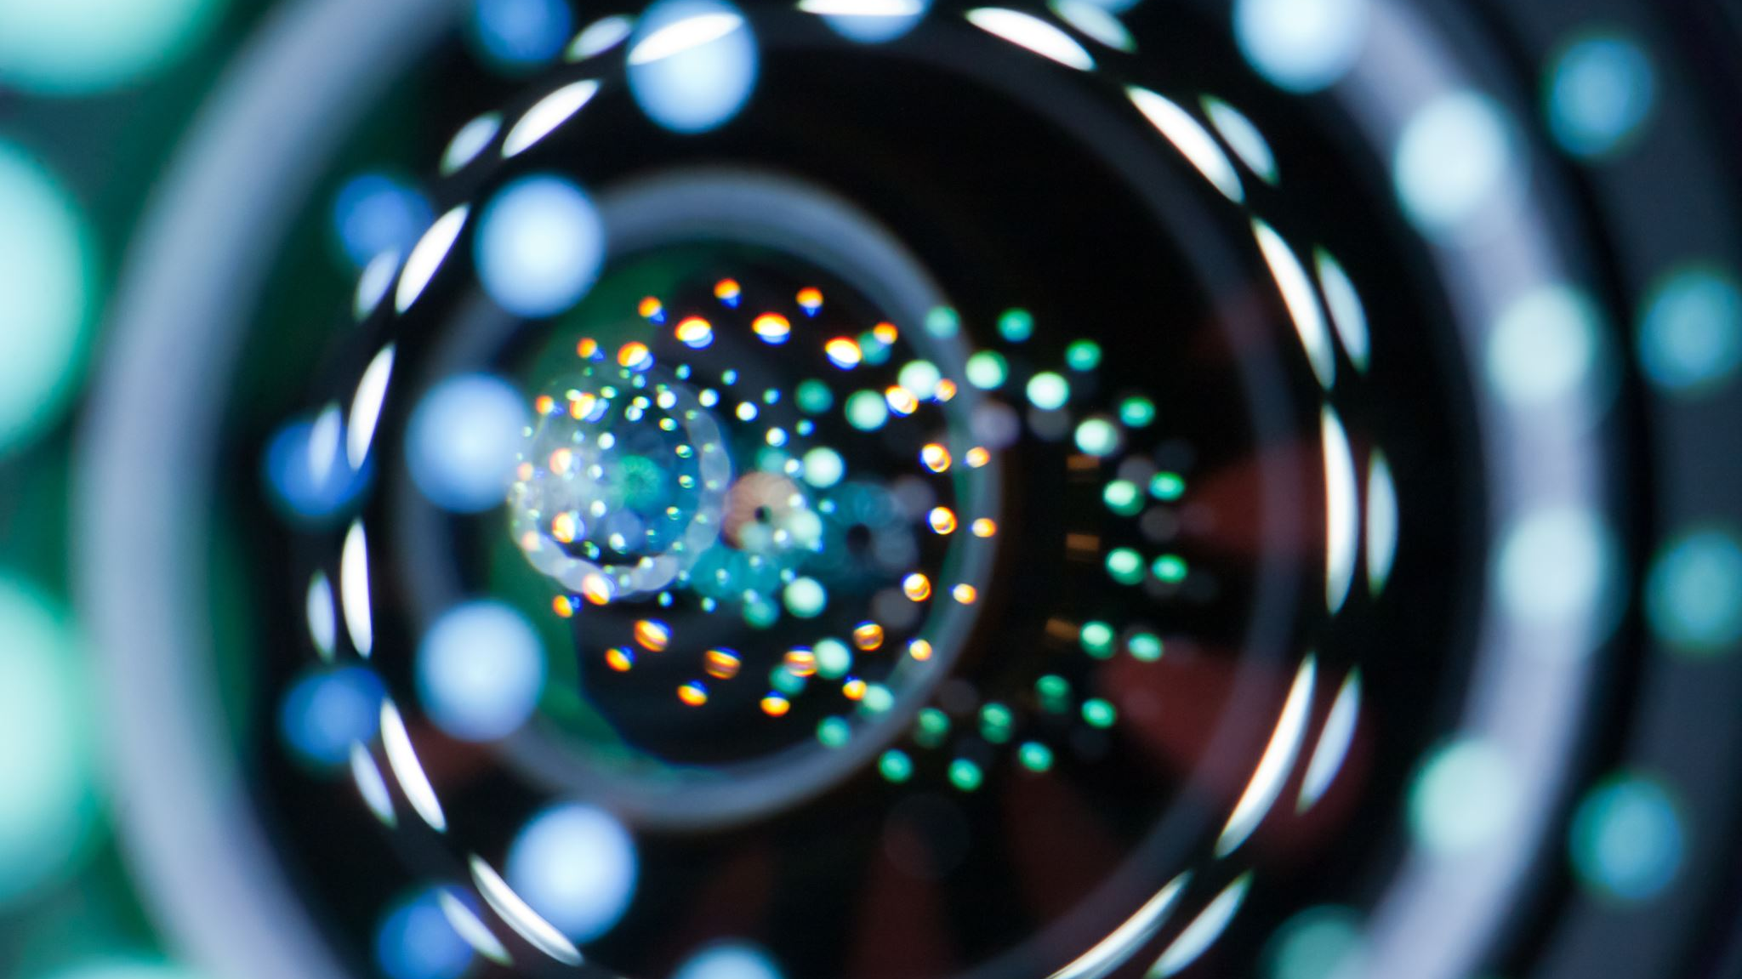
Scintillators
How scintillating!

Slide 18
Scintillator Operation
Scintillators emit visible light or UV radiation after ionization from radiation
The emitted light can be seen with the naked eye, but is often amplified
Many types and kinds of scintillation, know that plastic (organic) and some metals (inorganic) are the most common categories
Inorganic scintillators often require impurities (doping), but they are better at detecting photons

Slide 19
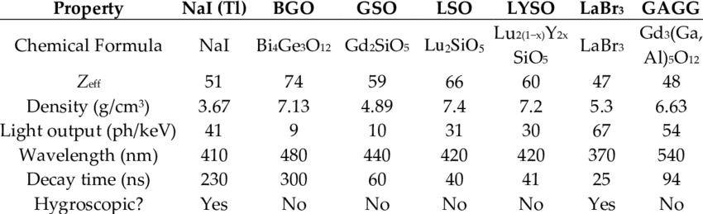
Common Nuclear Medicine Scintillators
BGO
LSO
NaI (Tl)
GSO
YSO
BaF2
LYSO
LaBr3
GAGG

Slide 20
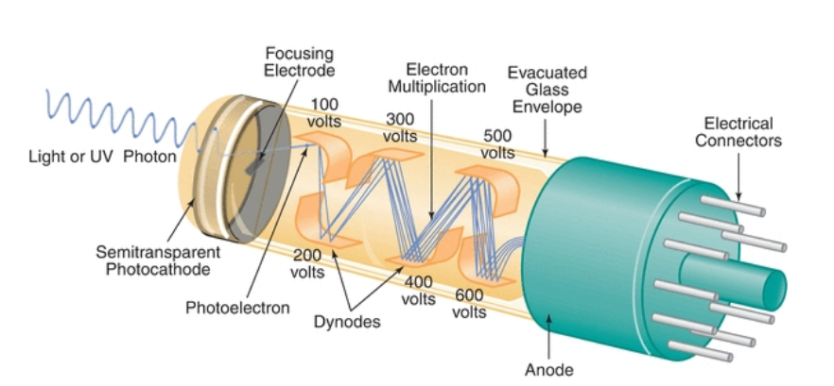
Photomarkiplier Tubes
Photomultiplier tubes capture light, convert it into electrical signal, then amplify the electrical signal
Extremely high-voltage
Very large
Often used in nuc. med.

Slide 21
Scintillator + Photodiode
Photodiodes may be used instead of PMTs
Used in many CT scanners and in-direct thin-film transistor mammography/radiology detectors
Light emitted from scintillator is captured by photodiodes and converted into electrical signal

Slide 22
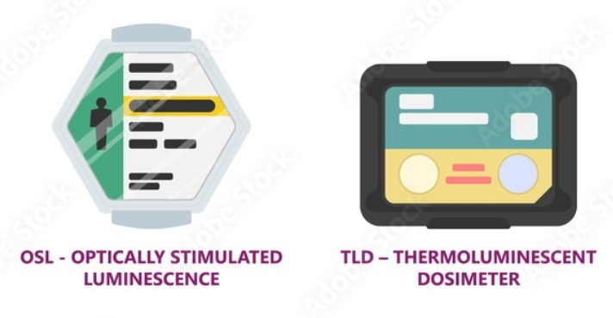
Trapping Scintillators
These scintillators trap excited electrons, which can be released later
Two main types,
  Thermoluminescent Dosimeters [TLDs]
  Optically Stimulated Luminescent Dosimeters [OSLDs] (now mostly defunct in therapy, but making a comeback)

Slide 23
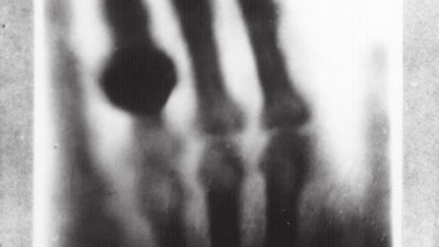
Film
Spooky ahh image

Slide 24
Motivation of Film
Permanent record
Great spatial resolution
Provides planar views of linac beams
Inexpensive in the short-term
Do not require electricity to use! (Developing Countries)

Slide 25
Types of Film
Radiographic
  Silver halide crystals in an emulsion are ionized which darkens produces an image when processed
  Requires careful processing in a dark room with chemicals
  AgBr is fixed and the irradiated Ag is washed away?
  High average Z is not great, and developing film really sucks
Radiochromic
  Better than radiographic!
  Self-developing
  Starts as light green, becomes darker after irradiation
  Takes approximately 24 hours to finish darkening
  GafChromic is the name-brand

Slide 26
